Slide 1



Code Search
汇 报 人： 胡刚
研究方向：代码摘要、代码搜索
邮 箱： hoogang@whu.edu.cn

Slide 2
Outline
Research Background
Related Work
Existing Techniques
Some problems
My thoughts

Slide 3
Research Background
As code search is a frequent developer activity in software development practices, improving the performance of code search is a critical task
As software systems keep evolving and growing, locating code for software maintenance becomes increasingly difficult.
The repositories containing billions lines of code, which are difficult for
developers to query in software development practices
It is difficult for a developer to format an accurate query to express what really original code description
Many existing text retrieval (TR)-based search techniques provide little support to query a ranked list of program code
On Code Search API, developers search for sample codes and need scan all results carefully to identify the answer

Slide 4

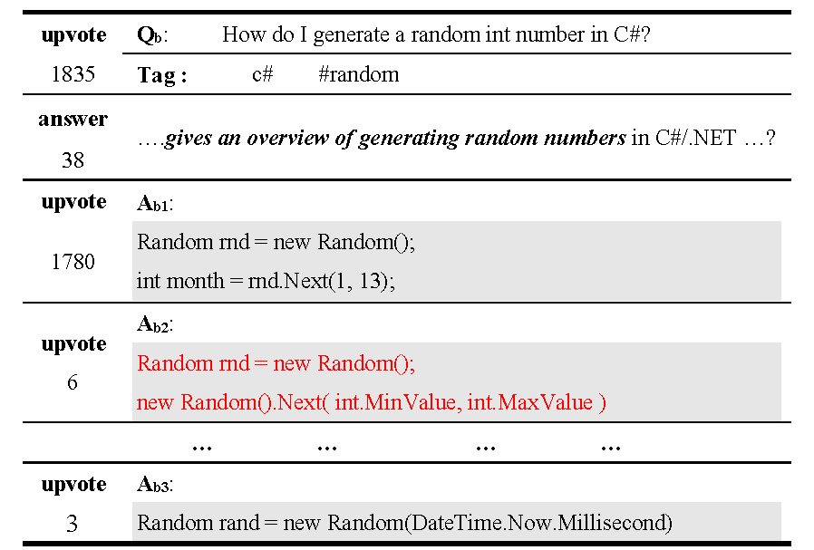
Code search engines–Stack Overflow, GitHub search, which are a potential source for searching relevant snippets in supporting APIs. Unfortunately, preparing an effective query is not only a challenging task but also is time-consuming for the developers to browse all answers.
Stack Overflow #2706500
huge amount
frequent changes
Why?
complex structure
software-specific words
Code formalization

Slide 5
text retrieval (TR)-based code search 、Query Expansion for code search、
Graph Embedding for Code Similarity Detection
Query Expansion via Wordnet for Effective Code Search (2015)
The words used in a query may be different from source code, propose an approach that extends a query with synonyms generated from WordNet
Neural Network-based Graph Embedding for Cross-Platform Binary Code Similarity Detection （2015）
propose a novel neural network-based approach to compute the graph embedding which used for measuring the distance between binary code
Summarizing Source Code using a Neural Attention Model(2017)
use the scoring function s to retrieve the highest scoring code snippet from our training corpus, scoring function computed using an LSTM neural attention model
RACK: Code Search in the IDE using Crowdsourced Knowledge（2017）
Translates the query into relevant API classes by mining keyword-API associations from Stack Overflow, and then applies the reformulated query to GitHub code search
Query Expansion Based on Crowd Knowledge for Code Search （2017）
Query Expansion based on Crowd Knowledge (QECK), QECK identifies software-specific expansion words from Stack Overflow to generate the expansion queries

Slide 6

Query Expansion via Wordnet for Effective Code Search (2015)
The approach implements query expansion with synonyms with the help of Wordnet
1.Query Preprocessing
2. Identifier Extraction
original query :“display lyrics”
code: “package eb.cstop.swing;”.
get words: {display, lyrics}
extract identifiers :{eb , cstop , swing}
{expose, exhibit, reveal, show},
3. Query Matching
{words, language, poem}
>threshold
expanded queries:
{display lyrics, expose lyrics, exhibit lyrics,
reveal lyrics, reveal lyrics, display words,,….}
“public void lyricsDowned (LyricsContents contents) ”=
{ get lyrics list, lyrics writer, is show lyrics, crystal lyrics list, set lyrics, lyrics content, get lyrics, lyrics list, show select list, lyrics selecter,lyrics downed, add lyrics, lyrics item, lyrics contents}

Slide 7
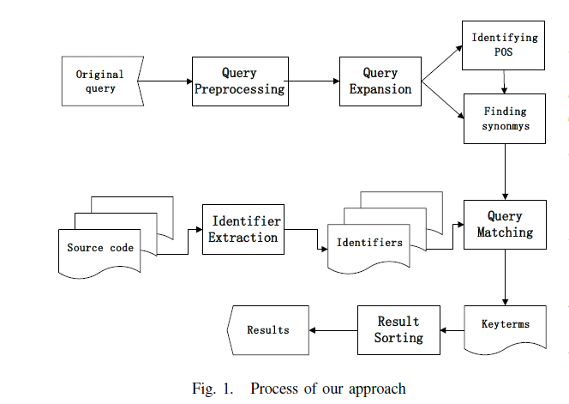
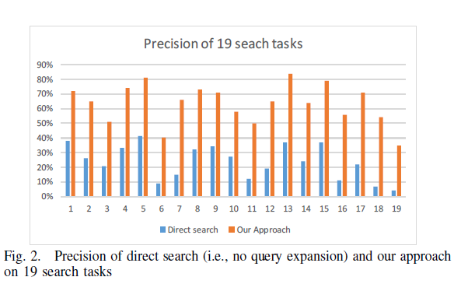
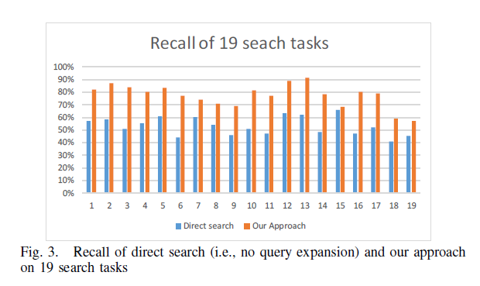
1、asked 20 volunteer Java developers with varying levels
of programming skills to perform 19 search tasks
2、set the similarity score threshold as 3/7 based on our
empirical investigation

Slide 8
Query Expansion Based on Crowd Knowledge for Code Search(2015)
WordNet could not effectively suggest similar words in software engineering context, as it does not contain many software-specific words;
Propose Query Expansion based on Crowd Knowledge (QECK) to improve the performance of code search
First, it automatically generates expansion queries without human intervention, as QECK employs PRF to automatically generate expansion queries
Second, it automatically generates expansion queries without human intervention, as QECK employs PRF to automatically generate expansion queries
Third, it identifies software-specific words from Q&A pairs by TF-IDF weighting function
Four, generates an expansion query by adding software-specific words to the original query.
!! Mismatch vocabulary problem between the queries and the code snippet
Q&A pairs can be extracted in the form of software-specific words as context of query
These software-specific words are more useful for in code search than WordNet

Slide 9
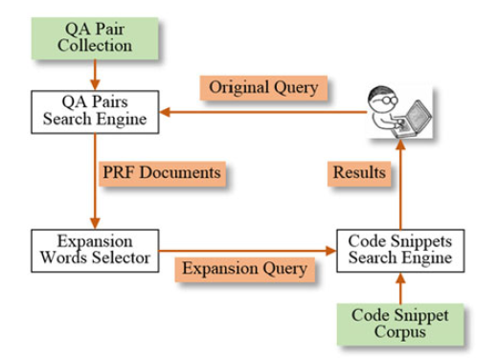
First-pass retrieval:
For the original query, we rank all Q&A pairs using a
particular information retrieval model (e.g., BM25
top-m Q&A pairs
Top-k
code snippets
QECK model
Word selection:
Identify useful top-n expansion words
from PRF Q&A pairs by the weights of words
Second-pass retrieval:
Rank all the top-k code snippets in corpus
related to the expanded query (e.g., BM25)

Slide 10
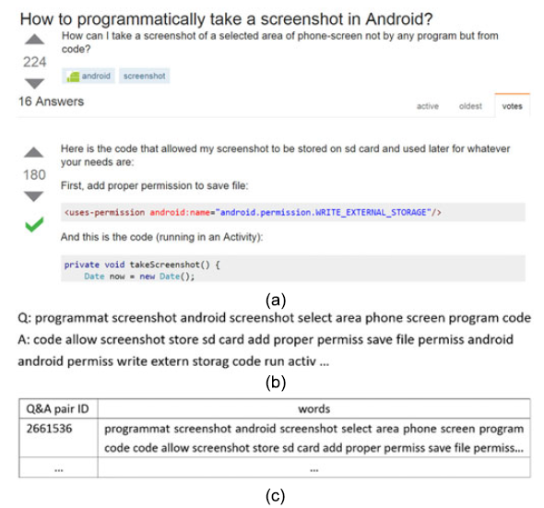

Stage1：Indexing Q&A Pairs
The terms in the questions and answers are split by Camel-case and separators, filter stop words, the remained words are handled by stemming
Q&A pair is represented
as a bag of words

Slide 11
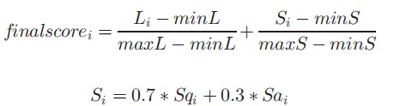
Stage2：Searching Q&A Pairs
Score is calculated textual similarity by BM for searching the top PRF Q&A pairs,
Lucene score
SO score
question
answer
Sqi: vote number in question unit
Sai : vote number in answer unit
Li: Lucene score, between Q&A pairs and query calculated by BM25 similarity
Rank the returned Q&A pairs in descending order
recommend top-m Q&A pairs as the PRF documents

Slide 12
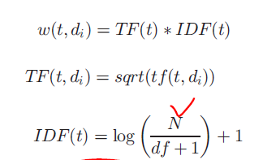
Stage3：Words Selection
Assumption that the words that are most closely related to the query will have a comparatively higher probability of occurrence in the feedback documents
After weighting the words
Top-n words identified as expansion words.
Eliminate some words appearing in more than 25 percent in expansion words

Slide 13
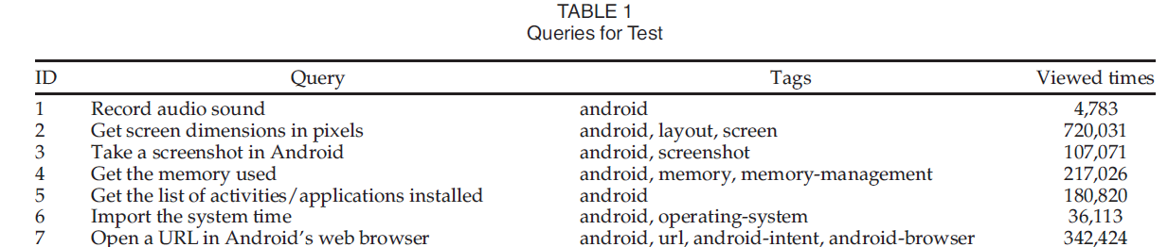

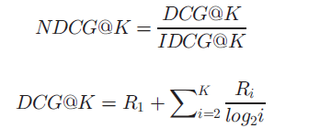
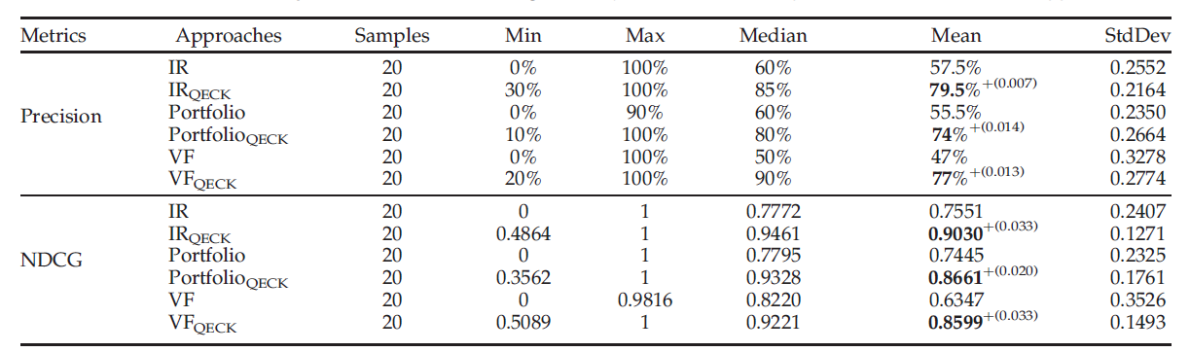
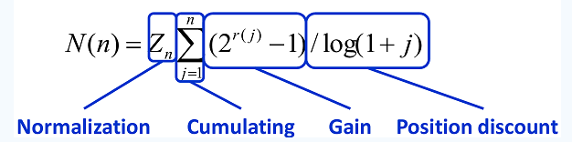
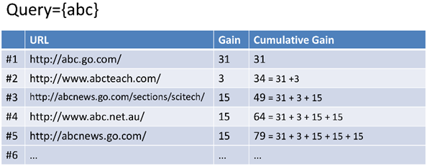
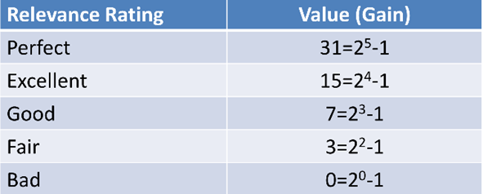
Collection containing 312,941 Q&A pairs with “android” tag
NDCG rank algorithm

Slide 14
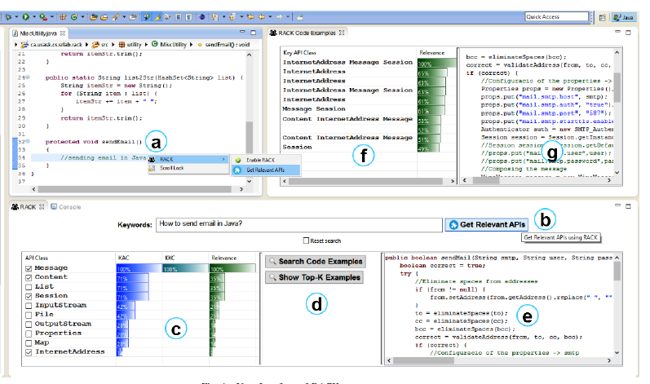
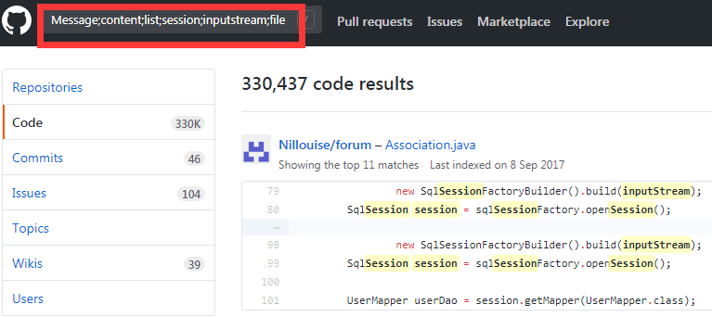
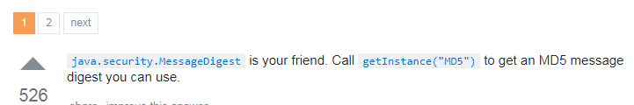
RACK: Code Search in the IDE using Crowdsourced Knowledge(2017)
3-Provides two options Top search examples in the IDE
4-extracted using AST parsing and textual
Similarity analysis with the query
returns the Top-K code snippets
1-Tool captures the comment as an initial query
2-captures the query from the search box for relevant API suggestion
Stackoverflow@415953 How can I generate MD5 hash?"
Three scores:
Keyword–API Co-occurrence (KAC), Keyword–Keyword Coherence (KKC), and Overall Relevance

Slide 15
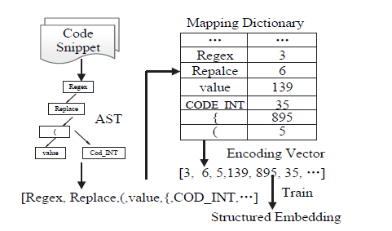
Query Expansion improves the performance of three code search algorithms
Insufficient external knowledge base?
Semantic relations between code and query ?
Integrate information of code structure ?
C# code snippet :
“Regex.Replace(value, ‘.f4g’,‘$0’).Trim()”

Slide 16
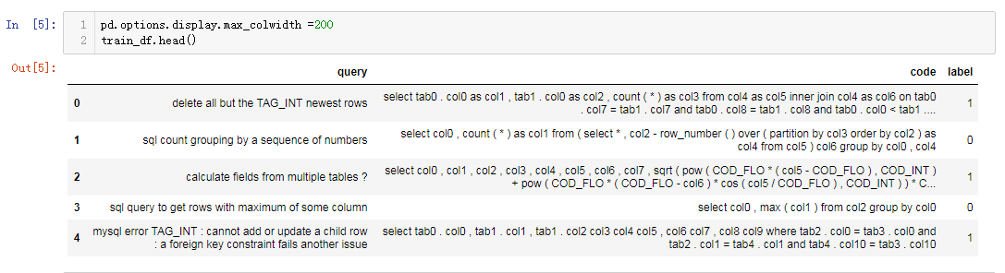
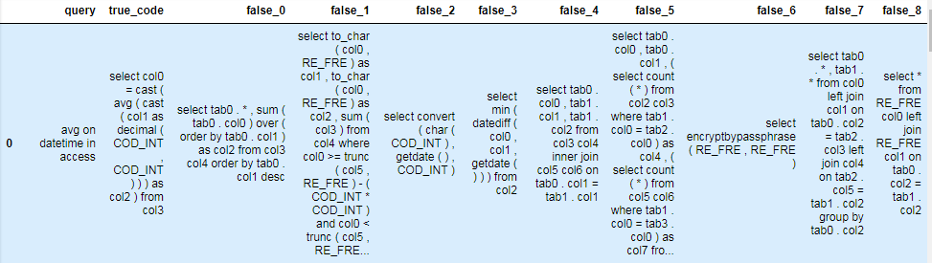
Train sets 25870
Valid sets and Test sets
3234, 3233

Slide 17


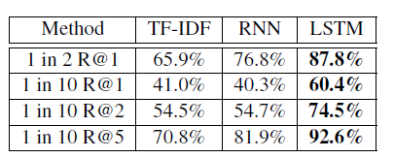
query
Word embedding
Structed
embedding
code
Random predictor
self-attentive embedding
self-attentive embedding
q_M=
128*256
c_M=
256*512
TFIDF predictor
256*126
512*256
M1
M2
q_en=
256*256
c_en=
256*256
The model predictor
euclidean metric (q_en.c_en)
Recall @ (1,10):0.68
Recall @ (2,10):0.73
Recall @ (3,10):0.82
Recall @ (5,10):0.88
Recall @ (6,10):0.92
20
sigmod
1
Label 0/1

Slide 18
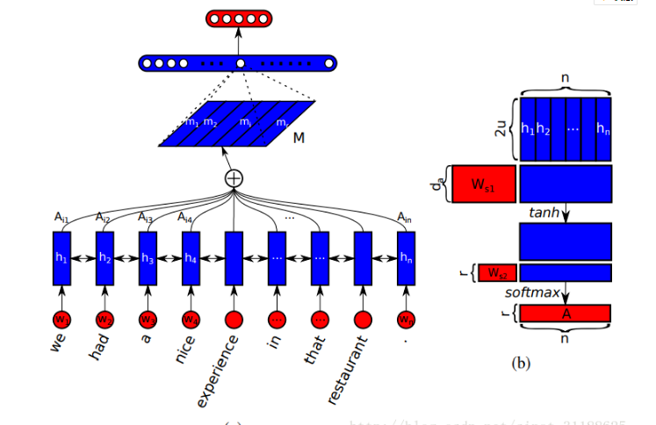

Lin Z, Feng M, Santos C N D, et al. A Structured Self-attentive Sentence Embedding[J]. 2017. ICLR

Slide 19
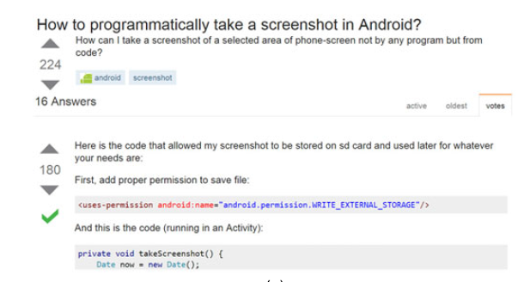
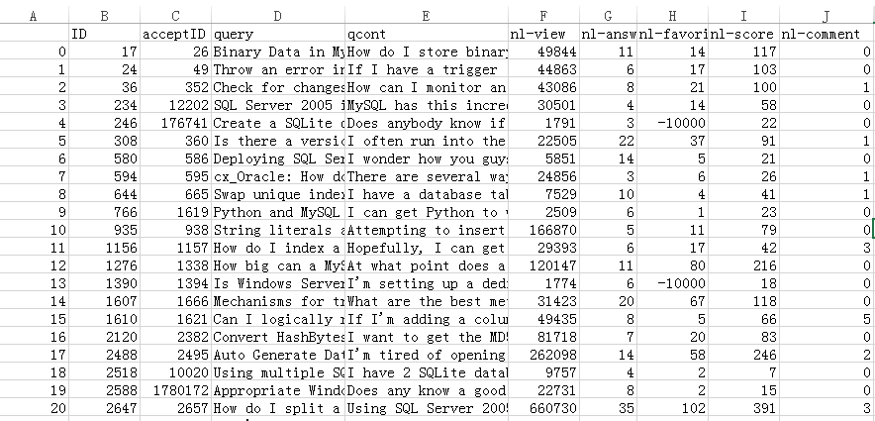
Query
Query Expansion
Extractive method
Top k code snippets
Code
Extract high quality
Q-A pairs
Nerual method
Query Expansion
Recall k@ 1
Give score for
code recommend

Slide 20


